Slide 1

Predicting company bankruptcy
Mudita Garg

Slide 2
The social cost of bankruptcy
The high individual, economic, and social costs inherent in corporate failures or bankruptcies have prompted efforts to provide better insight into and prediction of bankruptcy events.​
Bankruptcy prediction has been a focus of study in business analytics because of the importance of accurate and timely strategic business decisions.
The prediction of bankruptcy in companies is a problem that has concerned entrepreneurs, researches and even governments for years, since detecting early signs that a company is going to enter bankruptcy involuntarily and being able to save it from that process, can help reduce the economic losses that bankruptcy entails, both in quantitative and qualitative terms.

Slide 3
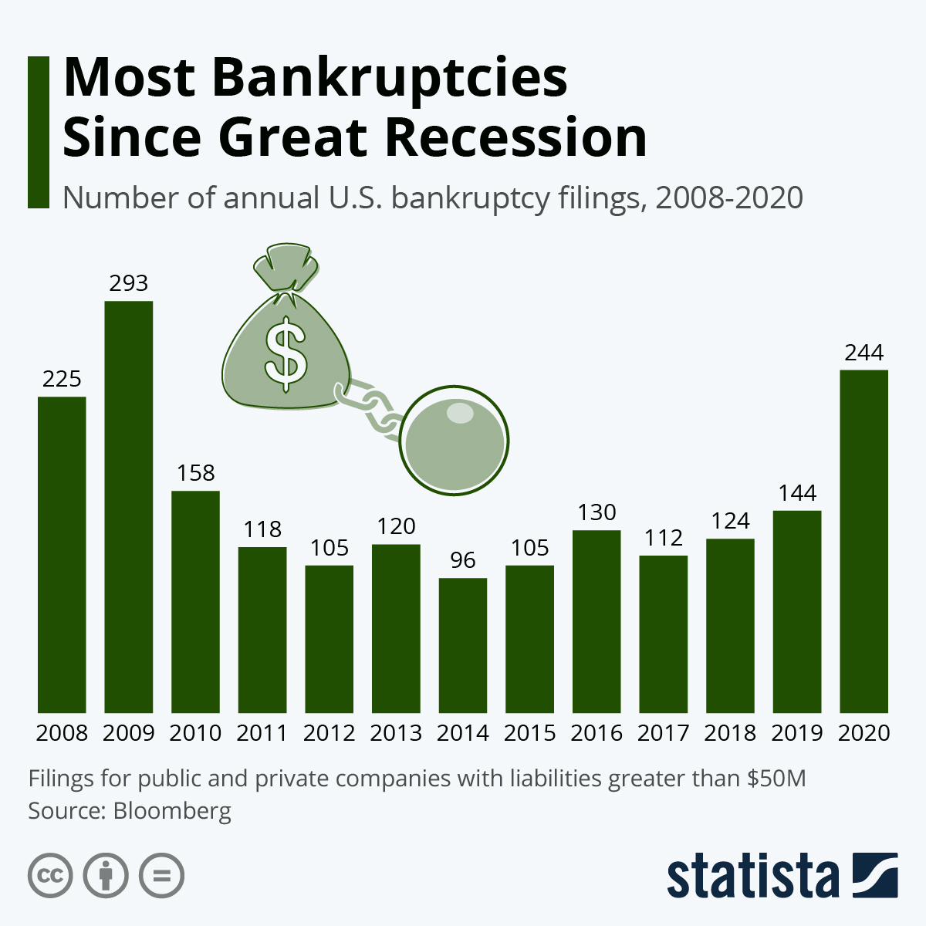
Statistics showing Number of bankruptcy fillings

Slide 4
Literature review
In this study, we will use bankruptcy data to test metrics for future estimation in logistic regression. In one report, we will concentrate on factors that could have an impact on the number of bankruptcies in various commodities, while in another, we will focus on bankruptcy patterns based on past years' number of bankrupts in the future.
The methods for predicting bankruptcy of financial firms became an important issue in the 1960s. High individual, economic, and social costs are inherent in corporate failures or bank failures and their findings could be taken as an indicator of the degree of development and robustness of a given country’s economy. Bankruptcy prediction has been a focus of study in business analytics because of the importance of accurate and timely strategic business decisions.

Slide 5
Source of the dataset
https://www.kaggle.com/fedesoriano/company-bankruptcy-prediction.​
The dataset is downloaded from the link given above. ​
The data is collected from the Taiwan Economic Journal for the years 1999–2009. Company bankruptcy was defined based on the business regulations of the Taiwan Stock Exchange.​
There are two criteria used in collecting the data samples. First, the sample companies had to have at least three years of complete public information before the occurrence of the financial crisis. ​
Second, there should be a sufficient number of comparable companies of similar size in the same industry for comparison of the bankrupt and non-bankrupt cases. ​
The resultant sample includes companies from the manufacturing industry composed of industrial and electronics companies (346 companies), the service industry composed of shipping, tourism, and retail companies (39 companies), and others (93 companies), but not financial companies.​

Slide 6
hypothesis
H0 (Null Hypothesis): None of the independent variable are significant predictors of a company's bankruptcies.
Ha (Alternate Hypothesis): At least one of the independent variable will be significant in predicting a company's likelihood to get bankrupted.

Slide 7
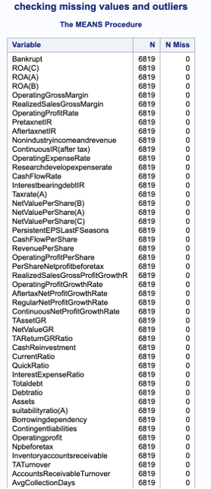
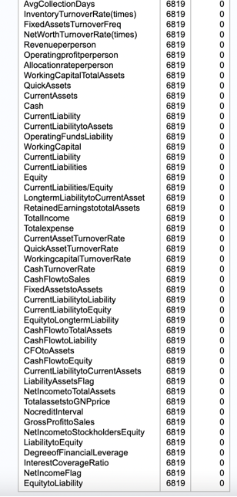
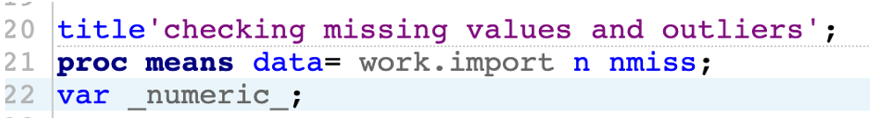
Exploratory Data Analysis (EDA)​
The dataset includes 95 variables and 6818 rows, with the target variable as bankrupt(y) with the values 0/1. ​
The dataset was imported with the name of WORK.IMPORT.​
As, the dataset is huge, we will check the missing values from the dataset

Slide 8
Step-wise regression
Model selection is a fundamental task in data analysis, widely recognized as central to good inference. In SAS PROC LOGISTIC, we have 4 automatic model selection techniques: forward selection, backward elimination, stepwise selection which combines the elements of the previous two, and the best subset selection procedure.
Selection is intuitively appealing: it builds models in a sequential manner and it allows for the examination of a collection of models which might not otherwise have been examined.

Slide 9
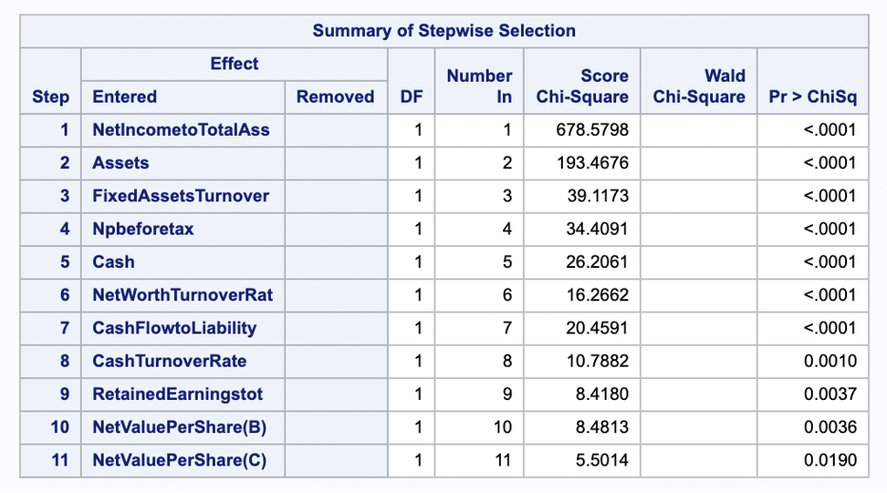
Reducing no. of variables using Stepwise Regression
A method of stepwise regression where all the independent variable begin in the model and subsequent variable are eliminated.
95 variables are a lot to work with. So, we will reduce the variables by using stepwise regression.​
Stepwise regression adds a variable one by one to the model based on the condition of slentry=0.05 slstay=0.01.​
The 12 variables (including y ) out of 95 were significant and were chosen.

Slide 10
Correlation Matrix
Correlation analysis in SAS is a method of statistical evaluation used to study the strength of a relationship between two, numerically measured, continuous variables. It is used to investigate MULTICOLLINEARITY between variables.
Correlation analysis creation between all variables and SAS scatter plot
The relation between two variables and their correlation can also be expressed in the form of a scatter plot or a scatter plot matrix.
PLOTS=MATRIX(options) Create a scatter plot matrix of the variables in the VAR statements.
PLOTS=SCATTER(options) Create individual scatter plots of the variables in the VAR statements.
SAS PROC CORR Procedure.
PROC CORR DATA=dataset <options>;
VAR variable(s);
RUN;
The VAR statement is where you specify all of the variables you want to compute pairwise correlations for. You can list as many variables as you want, with each variable separated by a space.

Slide 11
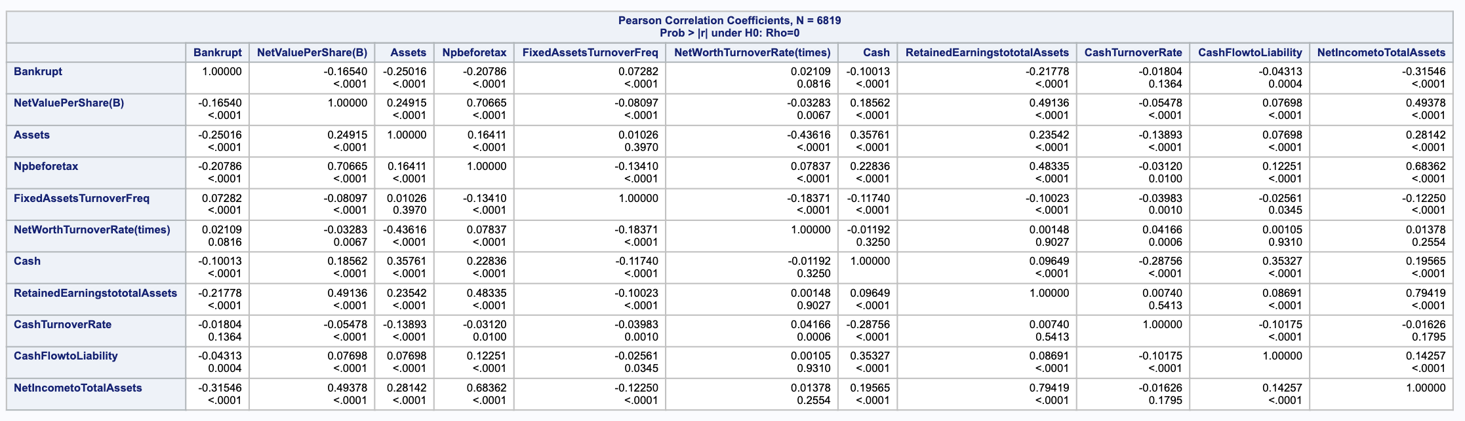
Correlation matrix
Correlation Matrix explains relationship between variables.
To plot, correlation matrix, Proc Corr data= work. Bankruptcy;
The values above 0.8 in the matrix can be referred as highly correlated variables.
In this matrix, Retained Earnings total assets and Net Worth Turnover Rate (times) are highly correlated (0.9).
Cash Flow to Liability and Net Worth Turnover Rate (times) are highly correlated (0.9).

Slide 12
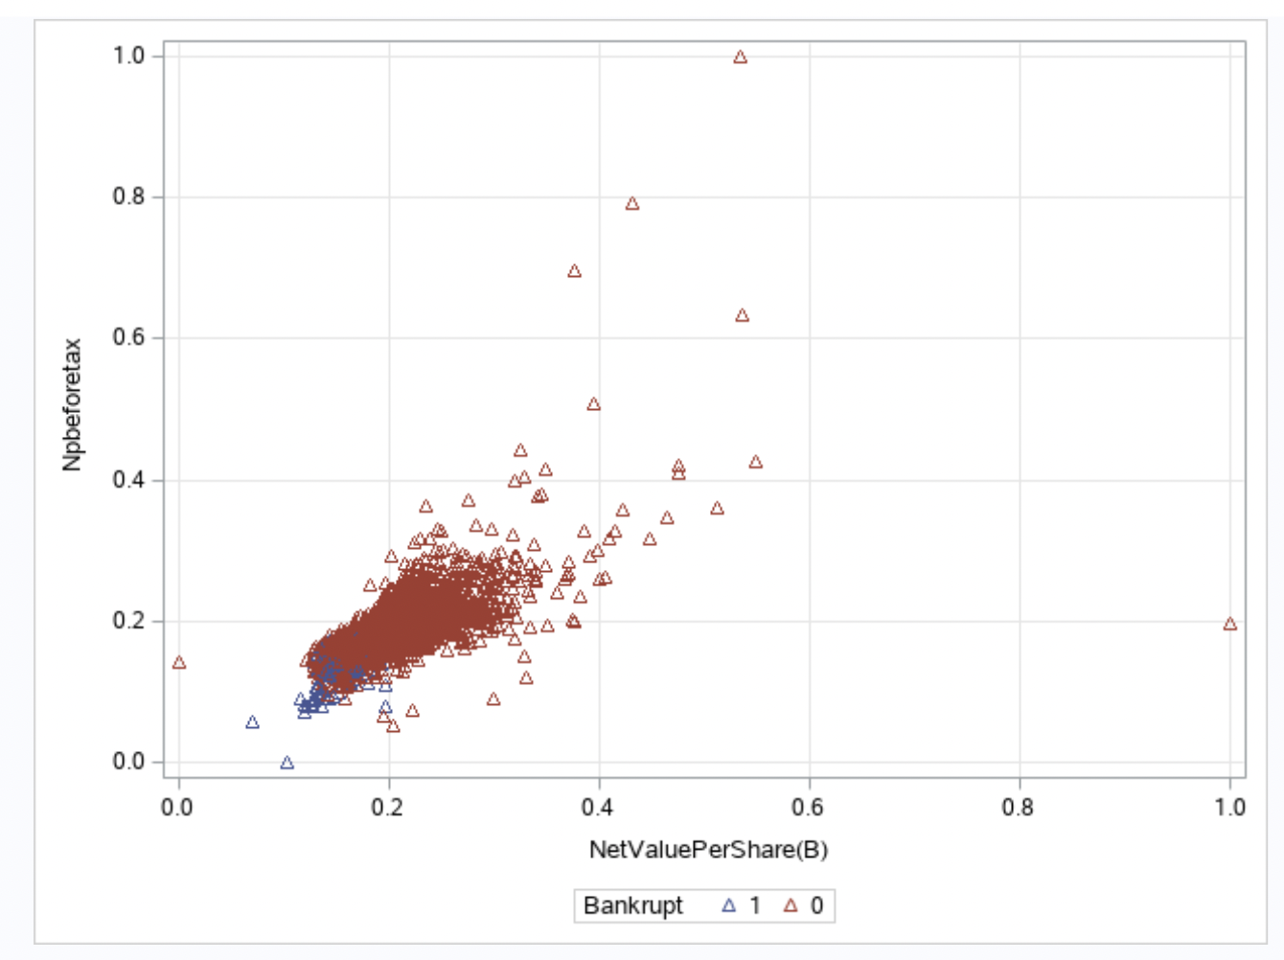
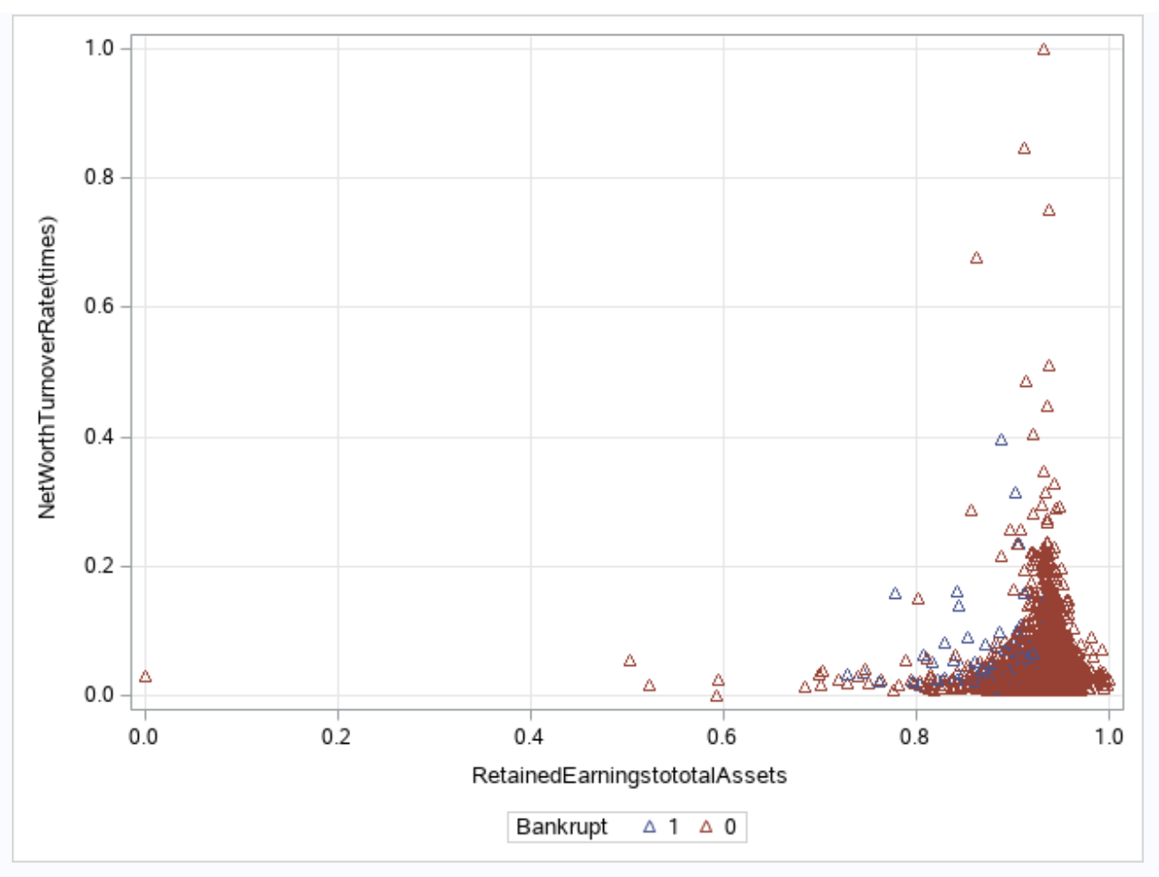
Checking relationship between highly correlated variables

Slide 13
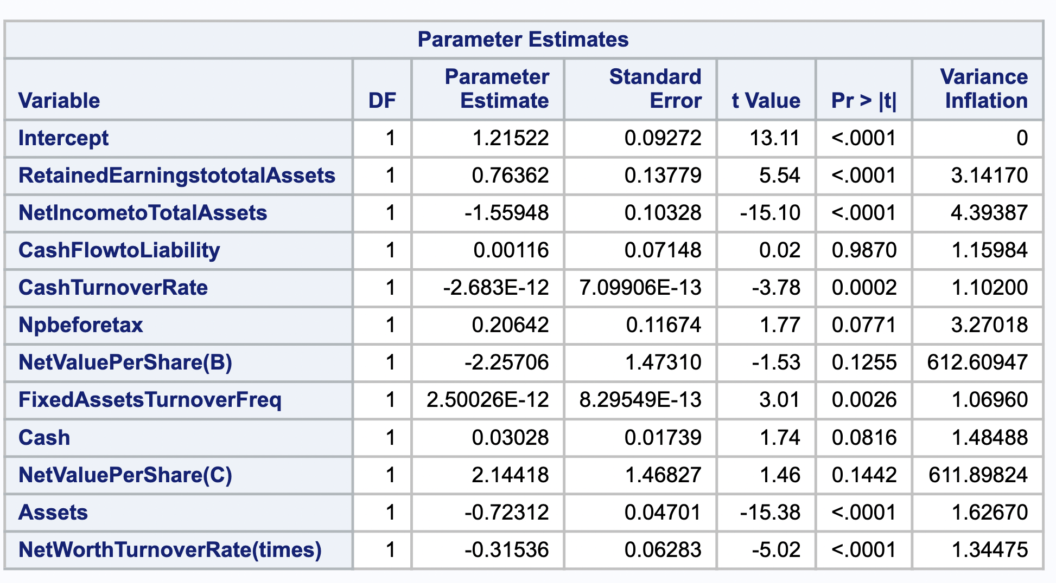
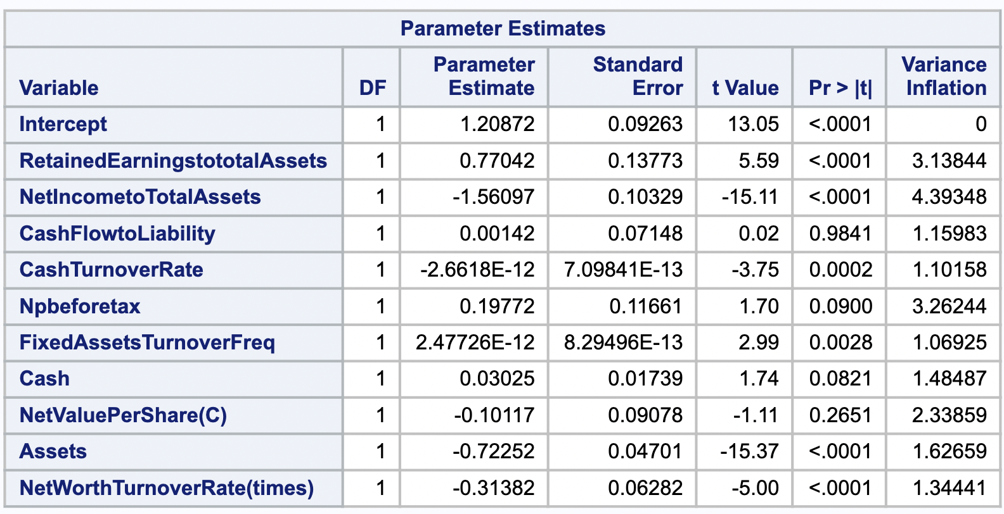
Checking Vif
It is used to investigate MULTICOLLINEARITY between variables.
NetValuePerShare (B) has highest value 612, so we will remove the highest value from the equation.
After removing the highest VIF, all values are under 10

Slide 14
Logistic Regression
Logistic regression is the application of multivariate analysis to be conducted once the variable quantity is divided(binary). Logistic regression is used to describe data and to explain the connection between one dependent binary variable and one or additional nominal, ordinal, interval, or ratio-level independent variables.
We have taken the binary dependent variable 0 and 1 to show the results in modeling with logistic regression.
Logit(p): Ln(p/1 - p)= β0+β1x + e
It also obtains the odds ratio in the presence of more than one explanatory variable.

Slide 15
Assumption of logistic reg
Binary logistic regression requires the dependent variable to be binary (0,1).
For a binary regression, the factor level 1 of the dependent variable should represent the desired outcome.
Only the meaningful variable should be included.
The independent variables should be independent of each other. That is, the model should have little or no multicollinearity.
The independent variable are linearly related to the log odds.
Logistic regression requires quite large sample sizes.

Slide 16
Need to balance the target variable?
Balancing data in a classification problem in modelling is where we have given some input (independent variables), and we must predict a discrete target. It is highly possible that the distribution of discrete values will be very different. Due to this difference in each class, the algorithms tend to get biased towards the majority values present and don’t perform well on the minority values.
Balancing target variable gives us the same amount of information to help predict each class and therefore gives a better idea of how to respond to the data.
There are a couple ways to do the balancing of data.

Slide 17
Different ways to balance dataset
Random under sampling- Random Under sampling aims to balance class distribution by randomly eliminating majority class examples. This is done until the majority and minority class instances are balanced out.
Advantages
It can help improve run time and storage problems by reducing the number of training data samples when the training data set is huge.
Random Over-Sampling- Over-Sampling increases the number of instances in the minority class by randomly replicating them in order to present a higher representation of the minority class in the sample.
Advantages
Unlike under sampling this method leads to no information loss.
Outperforms under sampling

Slide 18
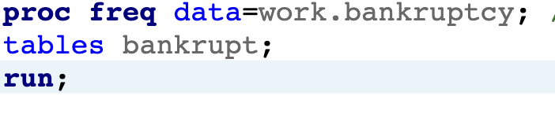
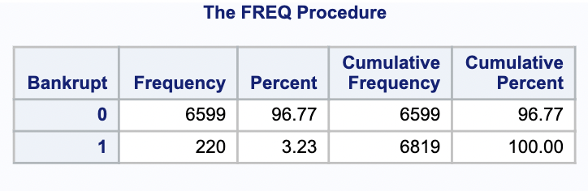
Checking the Target variable(y) balance
We need to check if our target variable (Y), which is bankrupt in the dataset is balanced or not.
bankrupt=0 here shows that the company is not going to be bankrupt.
Bankrupt=1 shows that the company is going to be bankrupted.
The below table show the percentage of the bankrupt are:
Bankrupt 0 = 96.77
Bankrupt 1 = 3.23

Slide 19
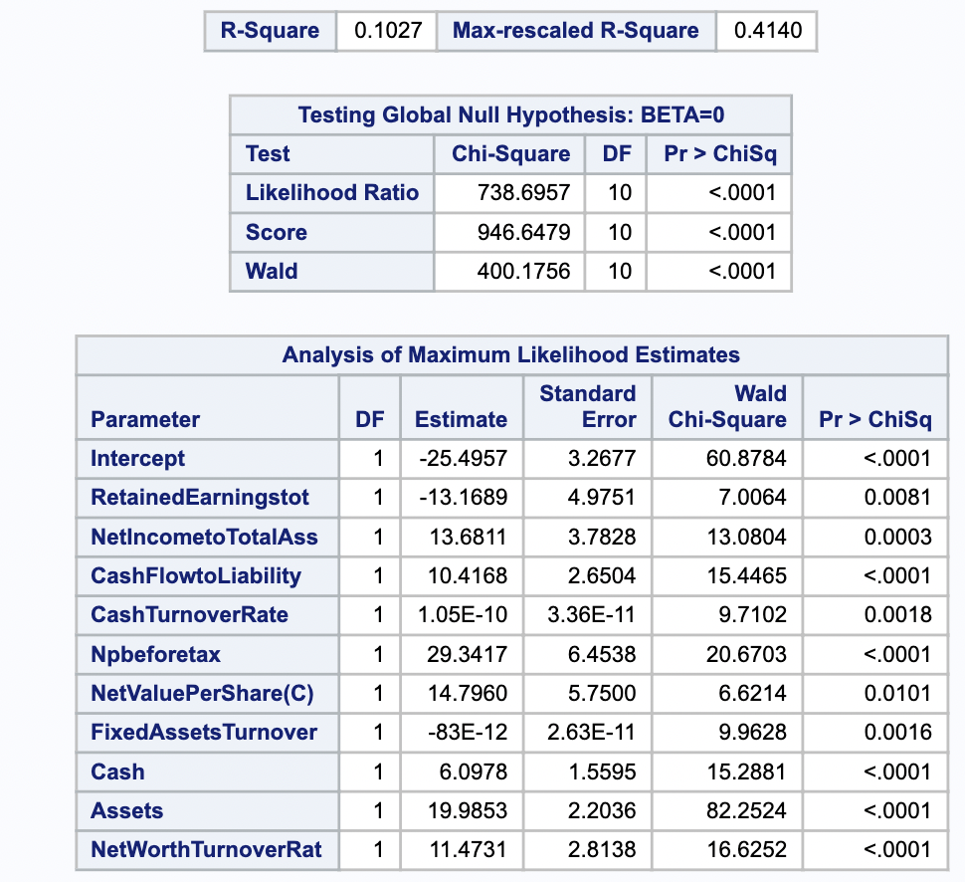
Proc logistic
We have used proc logistic to plot the variables. On plotting the variables with imbalanced dataset, the R-square is 10% and all the variables are significant.
Proc logistics also has the options to identifying the input and output data sets, suppressing the display of results, and controlling the response level ordering.
The logistic is used to estimate, as a function of unit changes in the independent variable, the probability that the event of interest will occur.
The main advantage is to avoid confounding effects by analyzing the associations of all variables together.

Slide 20
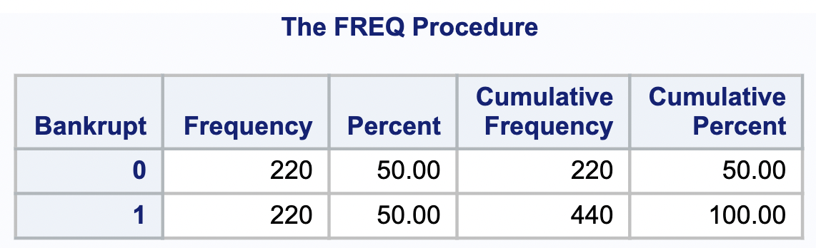
Data balancing
Filtering out all the Bankrupt=1 events
Filtering out all the Bankrupt=0 events
Reducing sample size of Bankrupt=0 to 220.
Combining both the datasets.
We will balance our target variable so that it doesn’t gives us bias results.

Slide 21
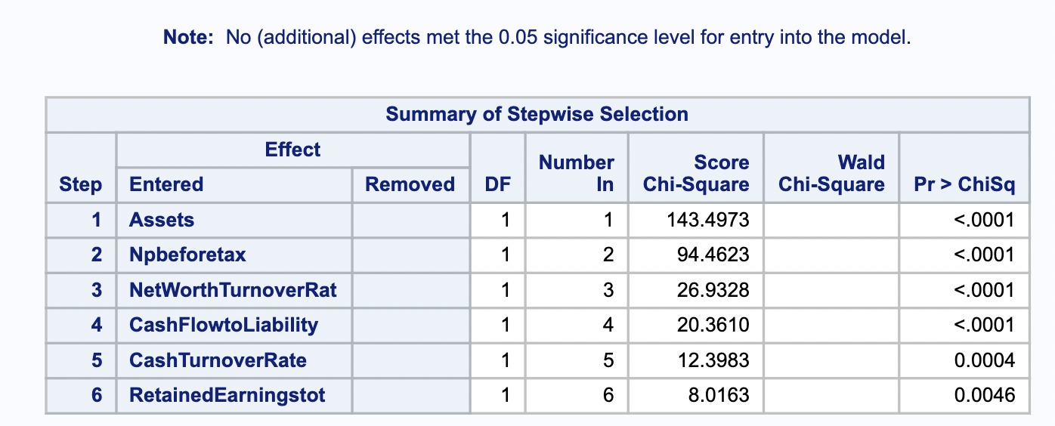
Stepwise after balancing the dataset
Stepwise selection is requested by specifying the SELECTION=STEPWISE option in the MODEL statement.
The option SLENTRY=0.05 specifies that a variable must be significant at the 0.05 level before it can be entered into the model, while the option SLSTAY=0.10 specifies that a variable in the model must be significant at the 0.10 level for it to remain in the model.

Slide 22
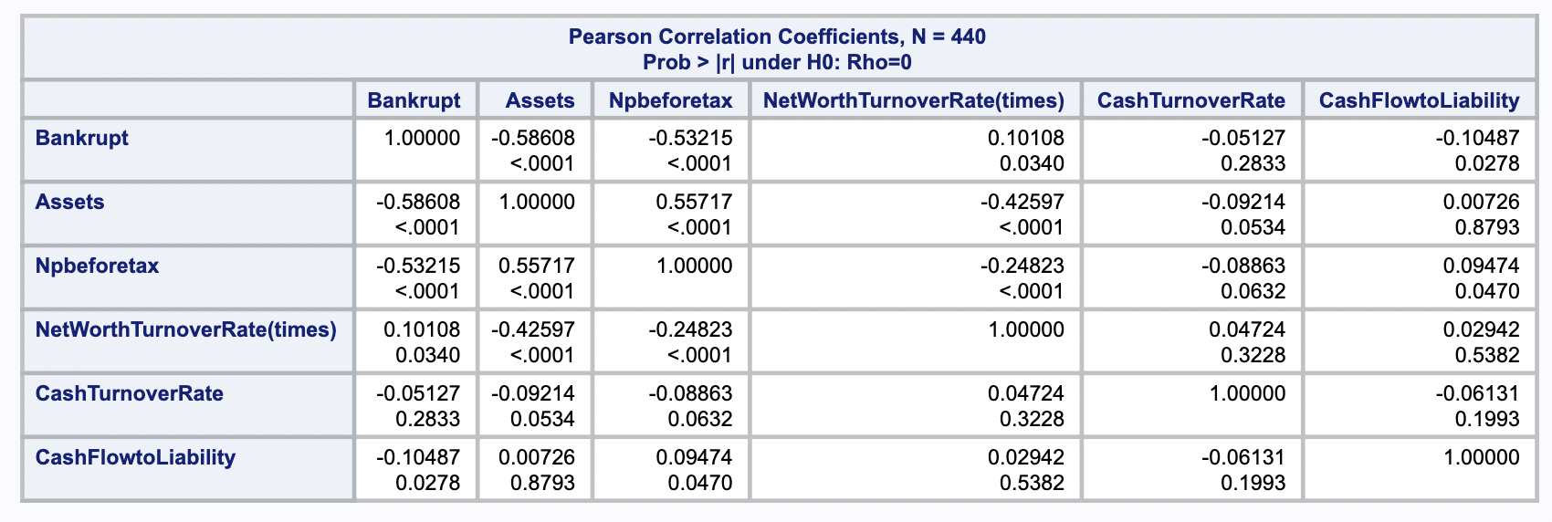
Correlation matrix
Correlation matrix to check if any of them is correlated.

Slide 23
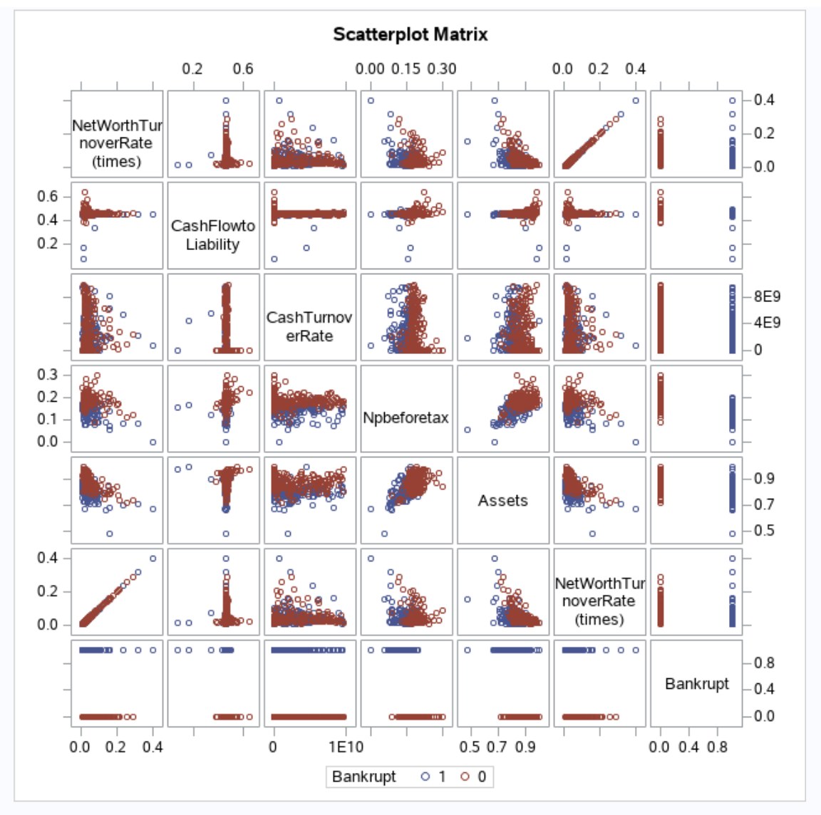
Relationship between variables
Scatter plot matrix to check relationship among the variables.
As you can see, there are many clusters formation in the matrix.
For example, assets and net profit before tax, as assets will grow, the company will have more profit.

Slide 24
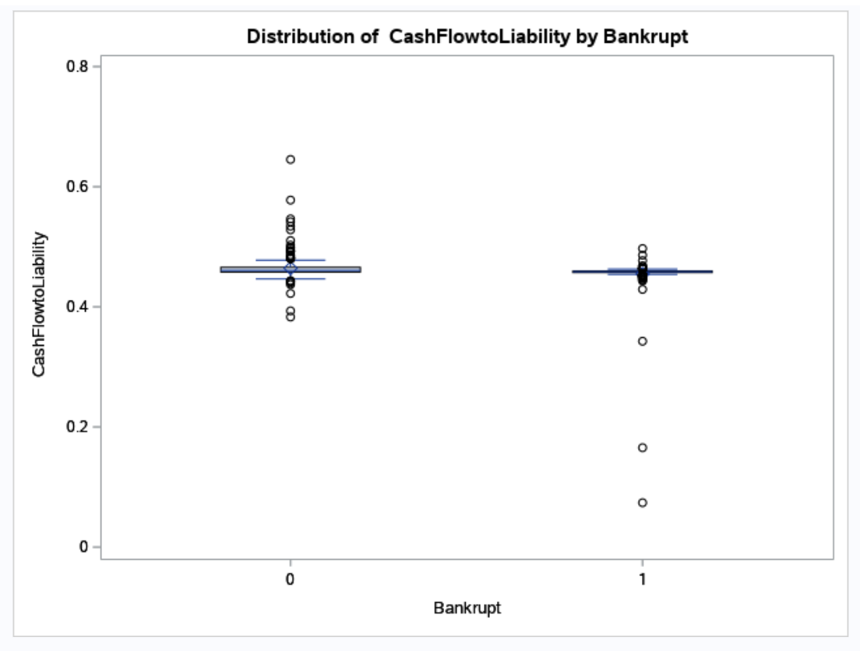
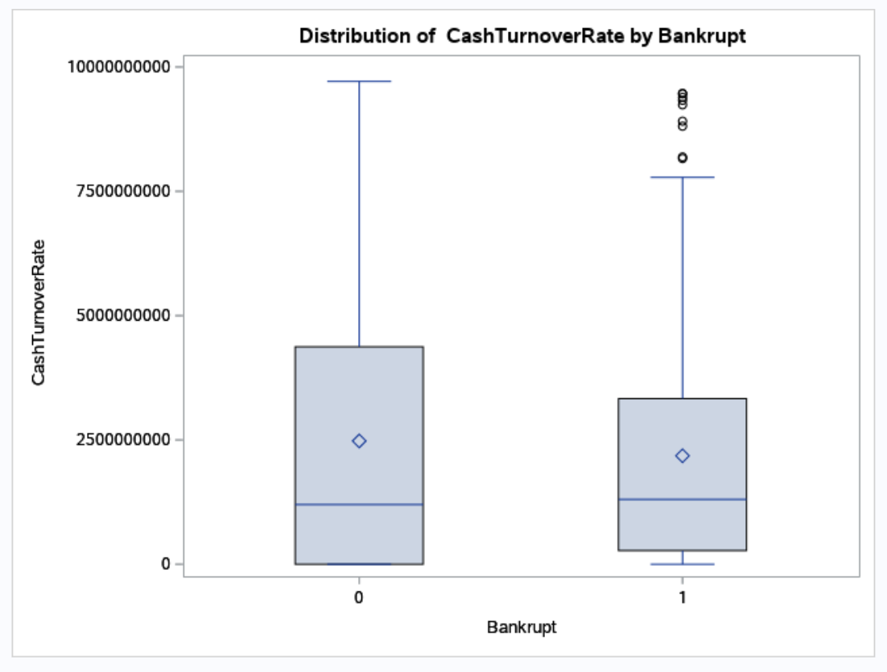
Outliers using boxplot

Slide 25
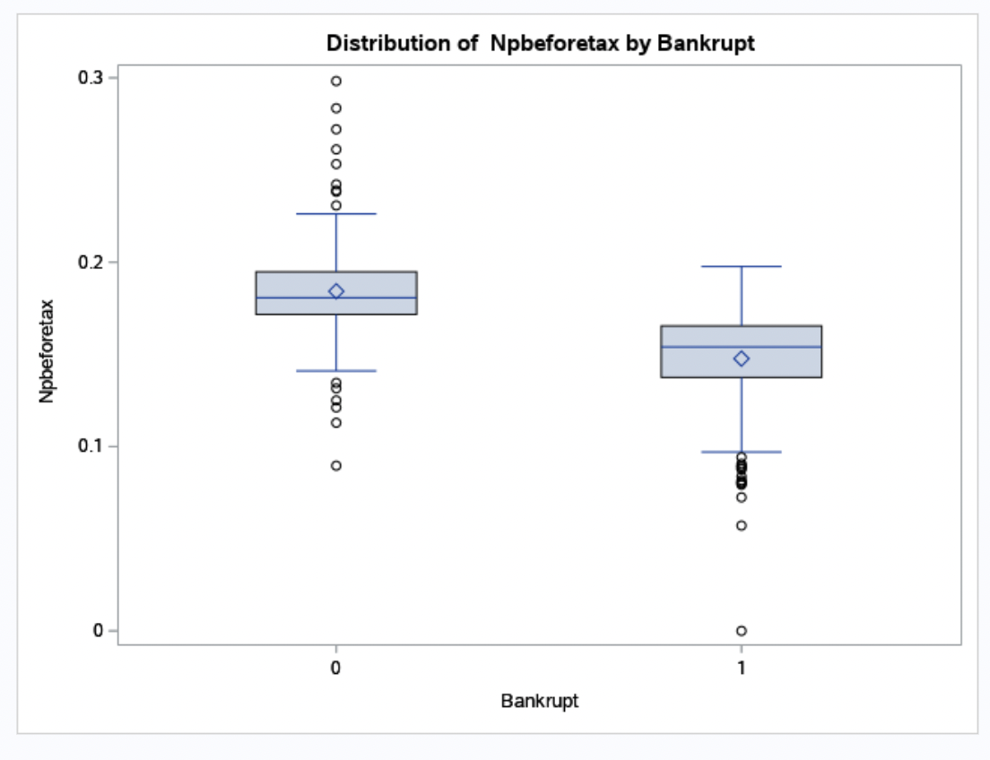
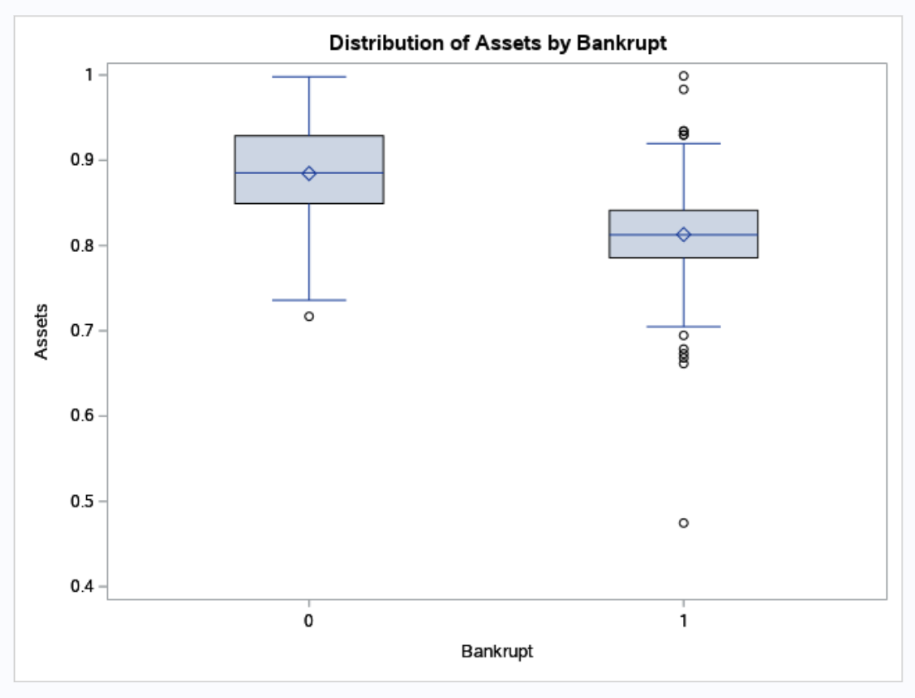
outliers

Slide 26
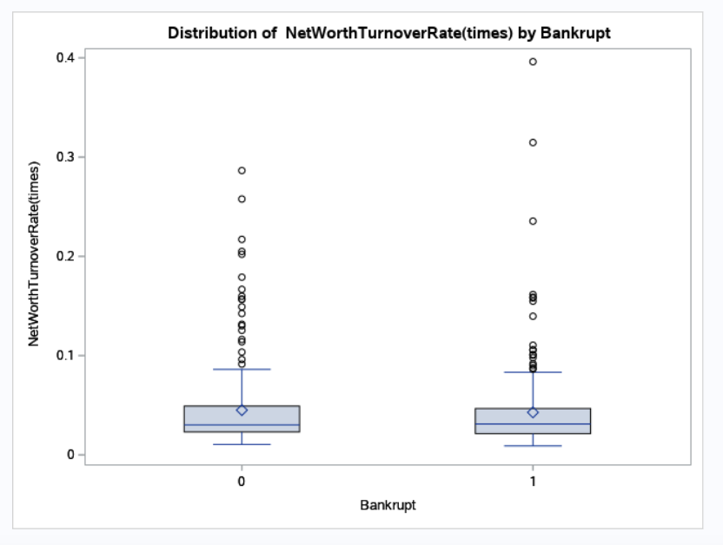
outliers

Slide 27
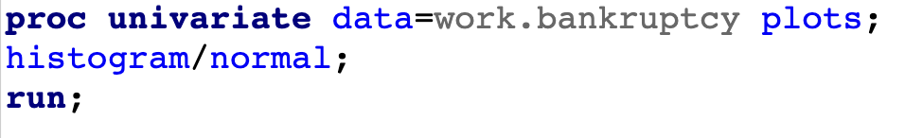
pROC UNIVARIATE PROCEDURE
PROC Univariate procedure provides descriptive statistics based on the moments (including skewness and kurtosis), quantiles or percentiles (such as the median), frequency tables, and extreme values.
PROC UNIVARIATE goes beyond what PROC MEANS does and is useful in conducting some basic statistical analyses and includes high resolution graphical features.
Output Delivery System (ODS) interface for this procedure will also be examined and demonstrated.
Below is the code for the PROC UNIVARIATE explains:
Histogram :A histogram is used to summarize discrete or continuous data. In other words, it provides a visual interpretation.
Normal : The option indicates a request for several tests of normality of variable(s).

Slide 28
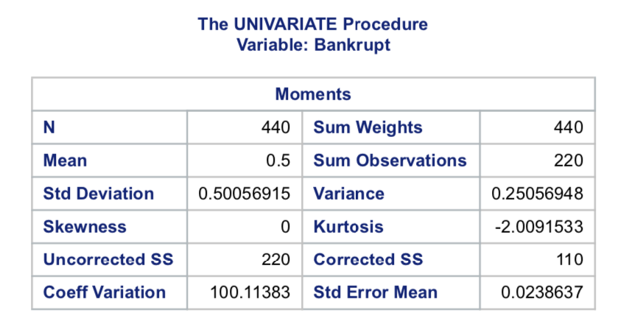
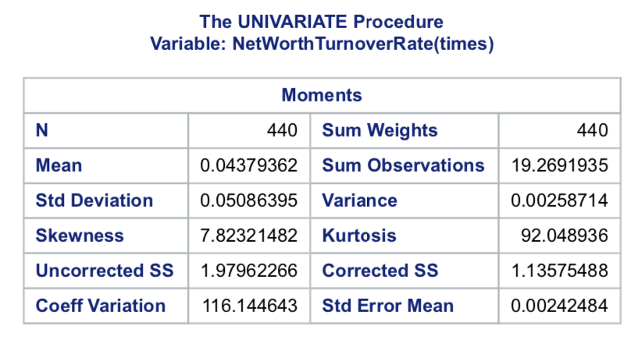
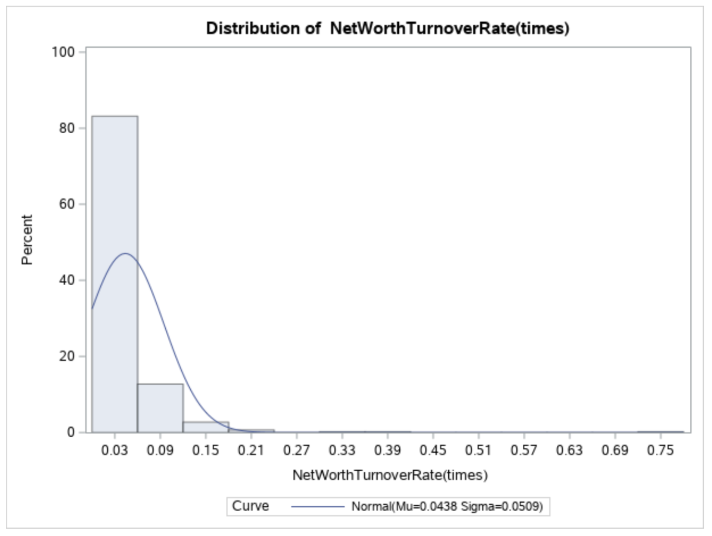
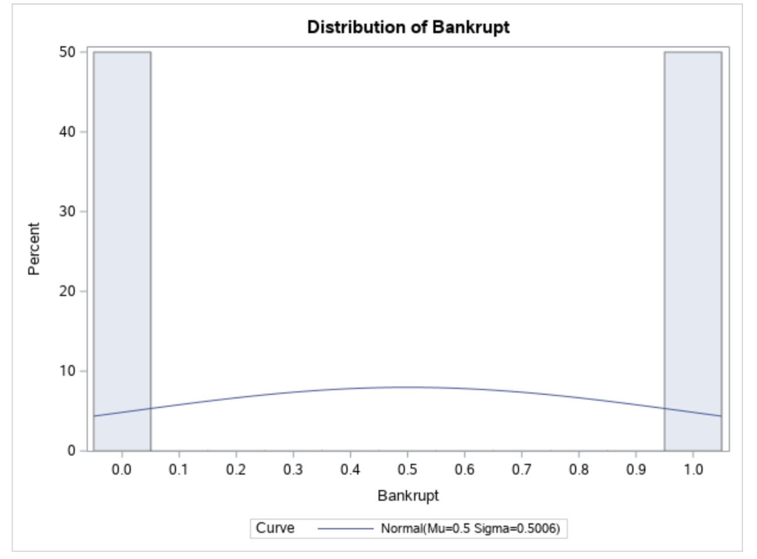
Proc univariate

Slide 29
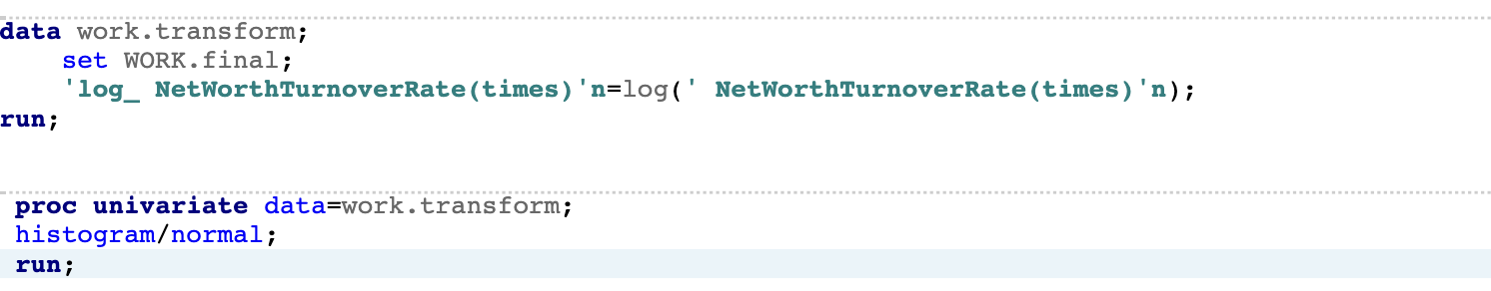
Transforming variable
Variable transformation is a way to make the data work better in your model. It is meant to change the scale of values and/or to adjust the skewed data distribution to Gaussian-like distribution through some “monotonic transformation”.
There are different transformations to apply to a variable. For example, inverse, square root, natural log, log base 10.
We have used natural logarithmic transformation, as the skewness was positively high, thus, to reduce the skewness to -3.4 to 3.4 range, we transformed this variable.

Slide 30
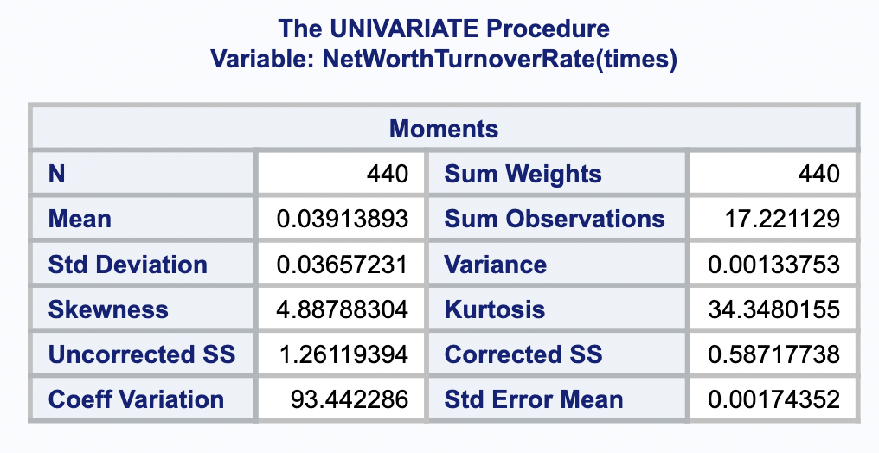
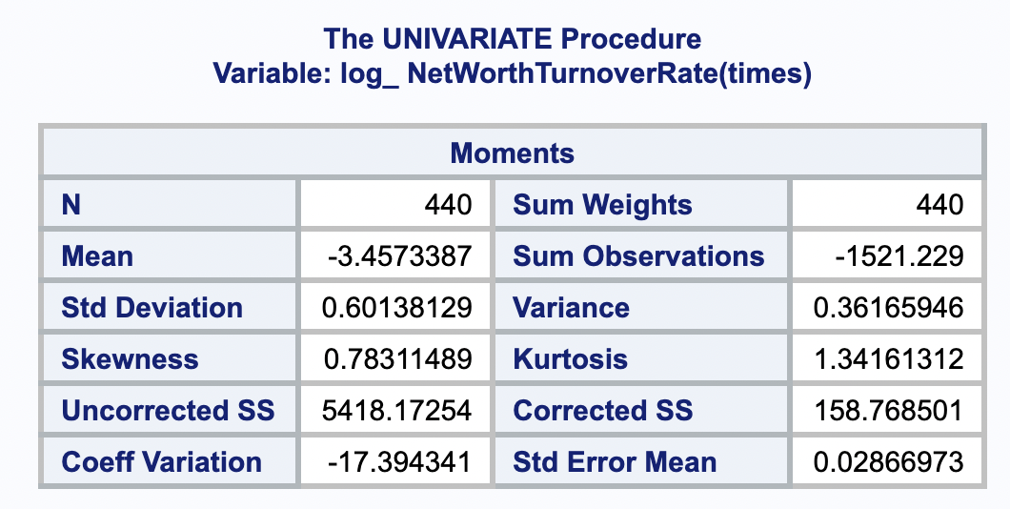
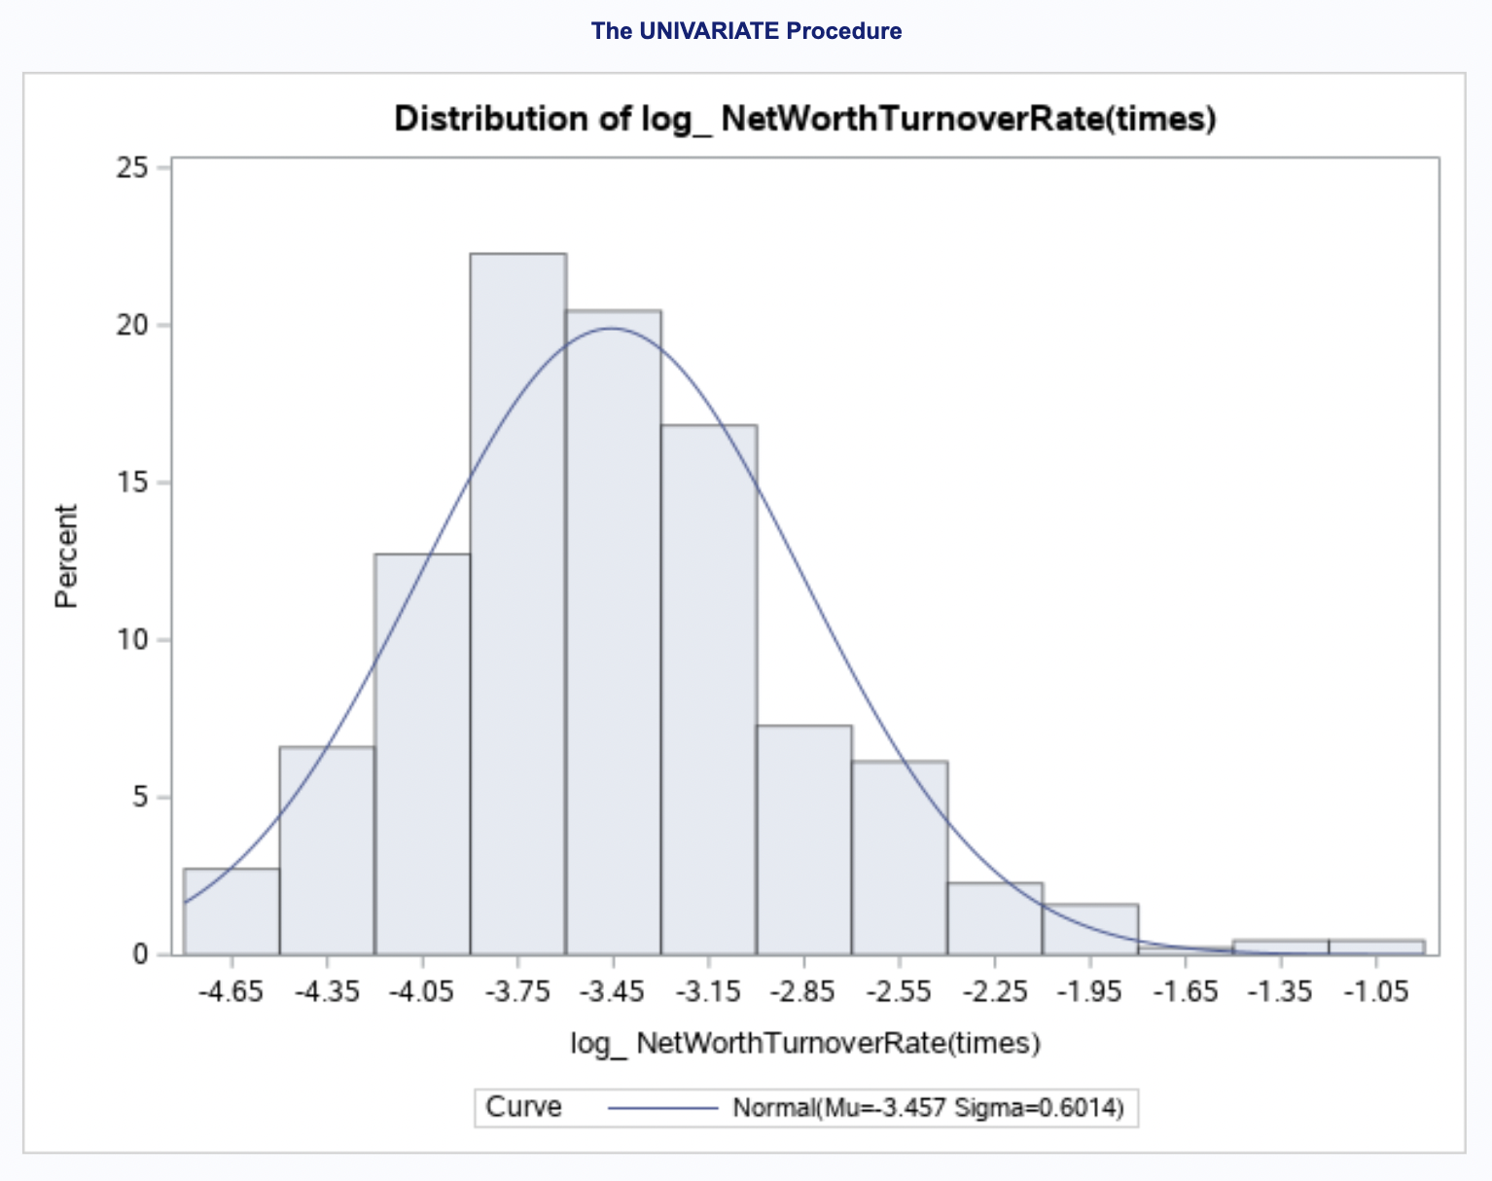
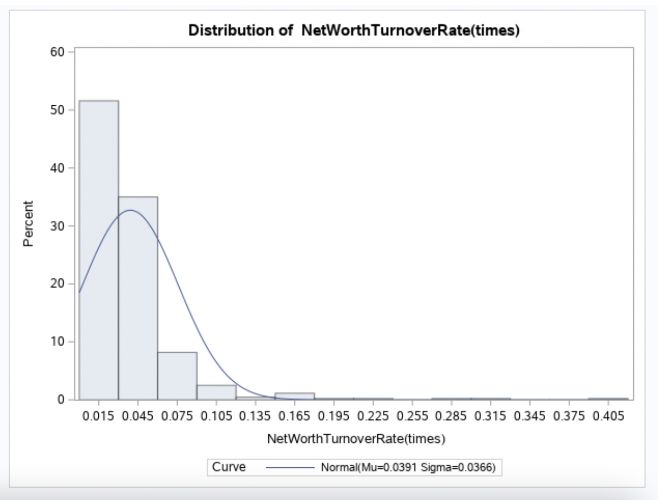
Comparing the Log variable after transformation

Slide 31
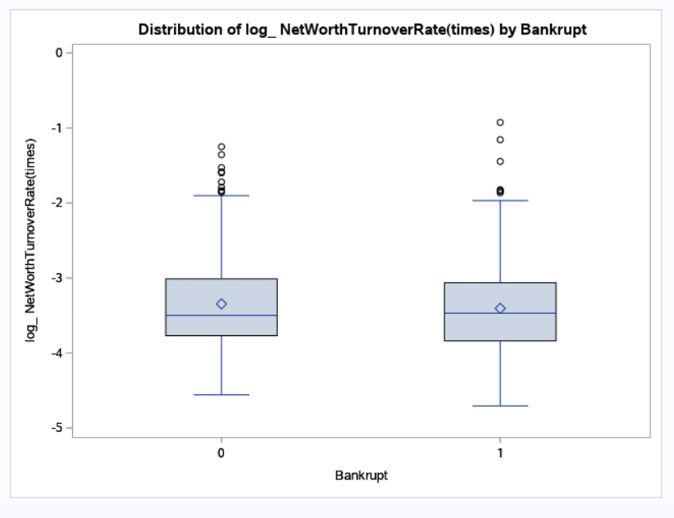
Outliers decreased after transformation of the variable

Slide 32
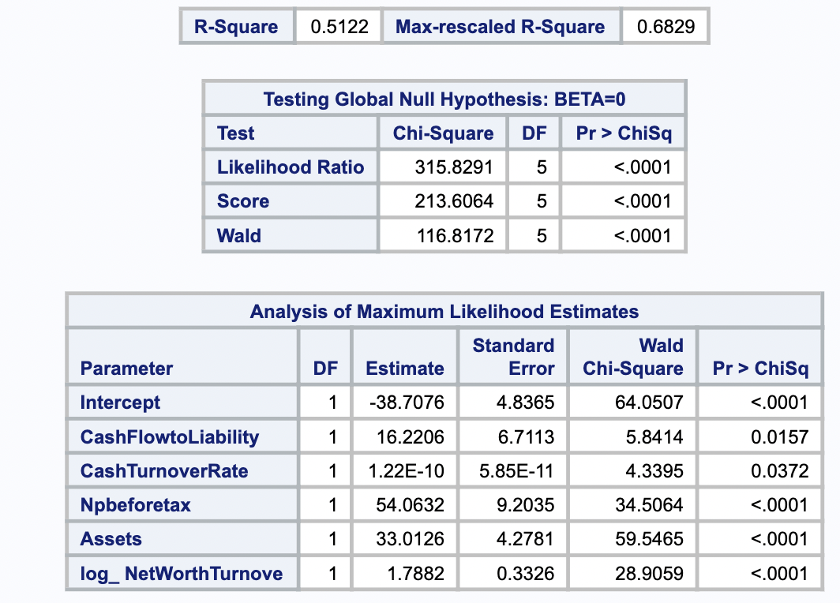
Logistic regression after data balancing
Logistics regression requires dependent variable which is in binary form i.e., 0 and 1. In data balancing if u have thirty 0 you also need thirty 1 to balance the data.
Imbalanced data can have a significant impact on model predictions and performance . Most often this involves classification problems where one class has a very small proportion of observations (e.g., defaults - 5% versus nondefaults - 95%).

Slide 33
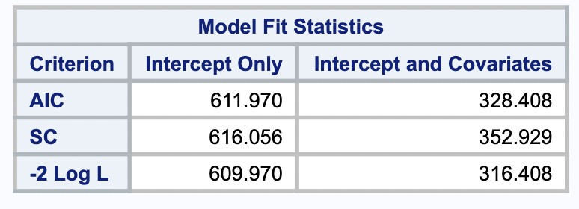
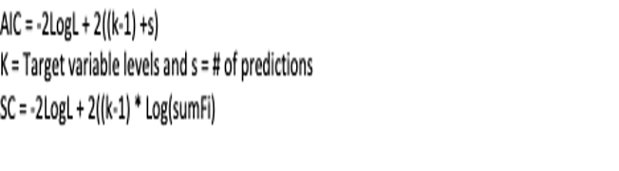
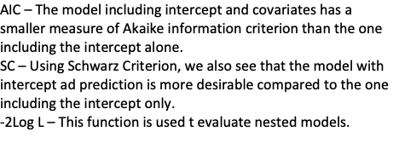
Model Fit Assessment

Slide 34
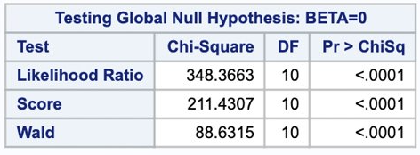
Chi – square & hypothesis tests
Likelihood Ratio: This is the Likelihood Ratio (LR) Chi-Square test that at least one of the predictors’ regression coefficient is not equal to zero in the model.
Score: This is the Score Chi-Square Test that at least one of the predictors’ regression coefficient is not equal to zero in the model.
Wald: This is the Wald Chi-Square Test that at least one of the predictors’ regression coefficient is not equal to zero in the model.

Slide 35
Conclusion
The experimental results, based on a real-world dataset from Taiwan, show that the FR categories of solvency and profitability and the CGI categories of board structure and ownership structure are the most important features in bankruptcy prediction. Therefore, the aim of this project is to assess the prediction performance obtained by combining different variables.
Since, all the variables had p values less than alpha, we reject the null hypothesis and accept the alternate hypothesis which states that these variables are important in calculating the dependent variable.
The rsquare of the model is 52%, if the sample size would have been greater, the rsquare value could have been better.

Slide 36
Discussion and future trend
One trend is the diversification of data sources. Former bankruptcy prediction papers would usually use numerical data, such as financial statement data, accounting data. Now the textual data, like news or public report even some comments from experts, are used to do the prediction. It generates a new concept called. Multiple-Source Heterogeneous Data, which requires more advanced classification techniques like deep learning technique, CNN.
Another possible innovative trend is to consider interpretability. Zhu et. al. (2013) proposed a comprehensive model to balance accuracy, complexity, and interpretability in the consumer credit classification [23]. However, it’s hard to find out which of the inputs has a stronger impact on bankruptcy using most of the conventional methods. This means most of the intelligent techniques are not suitable for investigating the cause of bankruptcy. Therefore, it’s necessary to think about how to promote the interpretability of prediction models.

Slide 37
references
https://data-flair.training/blogs/sas-correlation-analysis/
https://towardsdatascience.com/machine-learning-target-feature-label-imbalance-problem-and-solutions-98c5ae89ad0#b8f4
https://stats.idre.ucla.edu/sas/output/proc-logistic/
https://www.sciencedirect.com/science/article/pii/S0167923620301846
https://www.sciencedirect.com/science/article/pii/S0898122111008947
https://www.sciencedirect.com/science/article/abs/pii/S0957417419305123
https://www.sciencedirect.com/science/article/abs/pii/S0377221716000412

